Slide 1
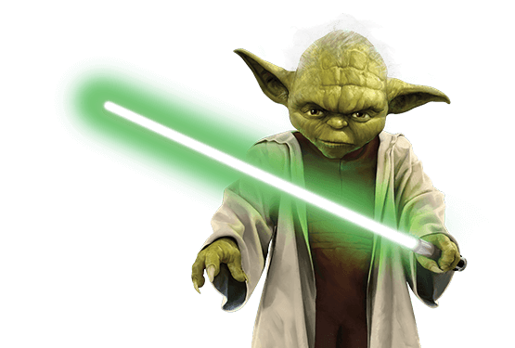


Test Driven Developmet with C# From Padawan to Jedi
Slides at scottsauber.com
scottsauber
Notes:
GitHub folder – HR Management System for demos

Slide 2

Audience
.NET Developers
Anyone interested in testing
Not sure where to begin with TDD
Seasoned TDDers
Basic knowledge of testing
scottsauber

Slide 3
Agenda
What different types of tests are there?
What is TDD?
Why TDD?
What do I test?
Live Demos
scottsauber

Slide 4
Goals
Learn “best practices*” for writing tests
Learn how to TDD with C#
* Synonym for “Just My Opinions” and I’ll probably find a way I like better in the future
scottsauber

Slide 5



Who am I?
Director of Engineering at Lean TECHniques
Co-organizer of Iowa .NET User Group
Microsoft MVP
Friend of Redgate
Blog at scottsauber.com

Slide 6
Testing

Slide 7
Why do we write tests?
Confidence our application works
Minimize manual work
Document behavior through tests
scottsauber

Slide 8
What kinds of tests are there?
Unit
Integration
End to End
…and more (Load, Stress, Smoke, etc)
scottsauber

Slide 9
Unit Tests
FIRST
Fast
Isolated
Repeatable
Self-validating
Timely
“Solitary”
scottsauber

Slide 10
Integration Tests
Invokes multiple parts of a system together
May have external dependencies
Usually less deterministic if there are uncontrolled dependencies
Useful for testing legacy code
“Sociable”
scottsauber

Slide 11
End to End Tests
Type of integration test
Invokes system from entry point to its end
Will have external dependencies
Will not be in memory
Usually slowest form of integration test
Usually less deterministic if there are uncontrolled dependencies
scottsauber

Slide 12
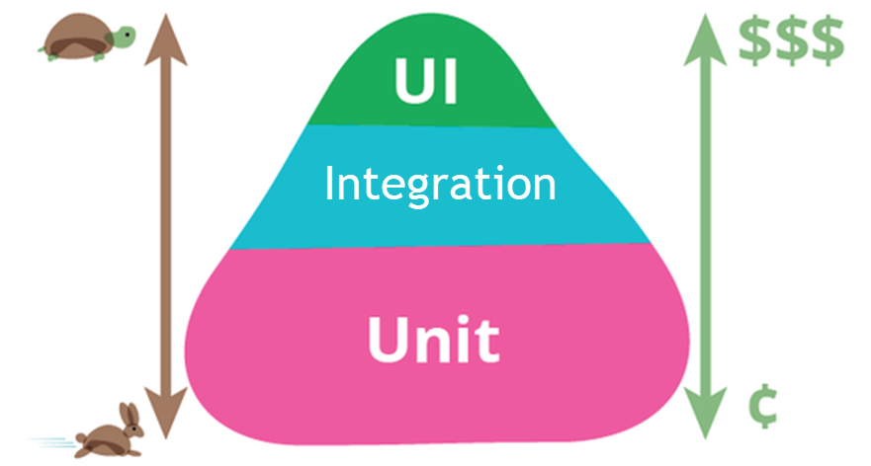
How many do I create of each?
scottsauber

Slide 13
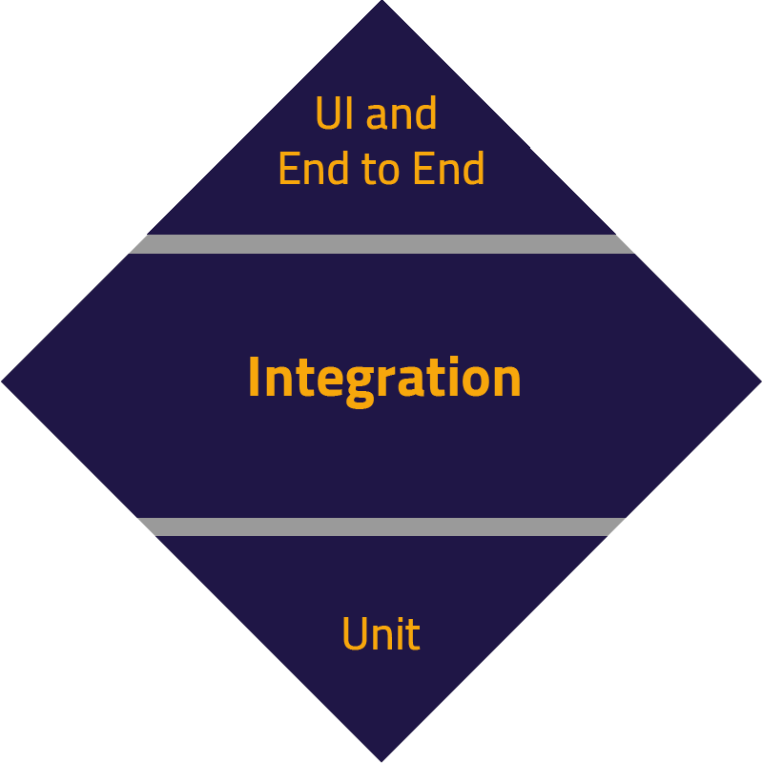
How many do I create of each?
scottsauber

Slide 14
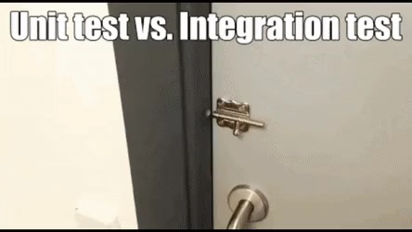
How many do I create of each?
scottsauber

Slide 15
Test Driven Development

Slide 16

What is TDD?
scottsauber

Slide 17
What is TDD?
A methodology for writing code (not tests)
You write the test BEFORE you write the production code
scottsauber

Slide 18
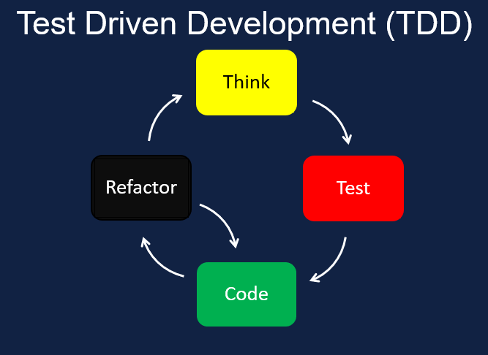
How do I TDD?
Think
Write a test that describes the behavior you want to see
Run the test to make sure it fails for the right reason
Write code to make it pass
Run the test to see it pass
Refactor
Repeat
scottsauber

Slide 19

“If you haven’t seen a test fail, you don’t know if it works.”
Eric Evans

Slide 20
What is NOT TDD?
TDD is NOT a synonym for writing tests
TDD is NOT writing multiple tests up front before writing any production code
TDD does NOT mean no bugs ever (just less)
TDD is not good for adding tests to existing production code
TDD zealots do more harm than good
scottsauber

Slide 21
Why TDD?
Work in small steps (minimizes waste, minimizes WIP)
Focus
Much less time in the debugger
Thinking through failure states
Confidence
Design feedback, hard to write test? Design might be wrong
Oh yeah… regression tests are nice too
scottsauber

Slide 22
What should I test?
Behavior
If I can delete code that breaks your app, but no test breaks… ⚠️
If my tests are broken, but my application isn’t… ⚠️
Don’t use snapshots (…mostly)
Snapshots don’t capture desired behavior
You can’t TDD snapshots
Snapshots can be useful when doing a huge refactor but output should be the same
Use them for that - then delete the snapshot
scottsauber

Slide 23

“I’m not a great programmer. I’m a good programmer with great habits.”
Kent Beck

Slide 24
TDD Demo

Slide 25
Slight TDD Detour

Slide 26
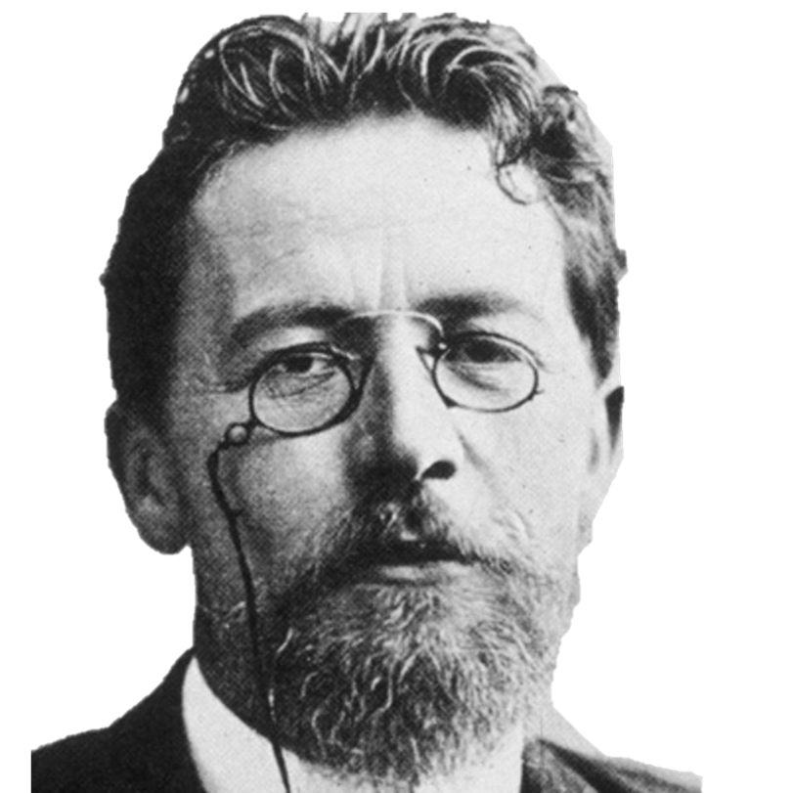
“Remove everything that has no relevance to the story. If you say in the first chapter that there is a rifle hanging on the wall, in the second or third chapter it absolutely must go off. If it's not going to be fired, it shouldn't be hanging there.” Anton Chekhov

Slide 27
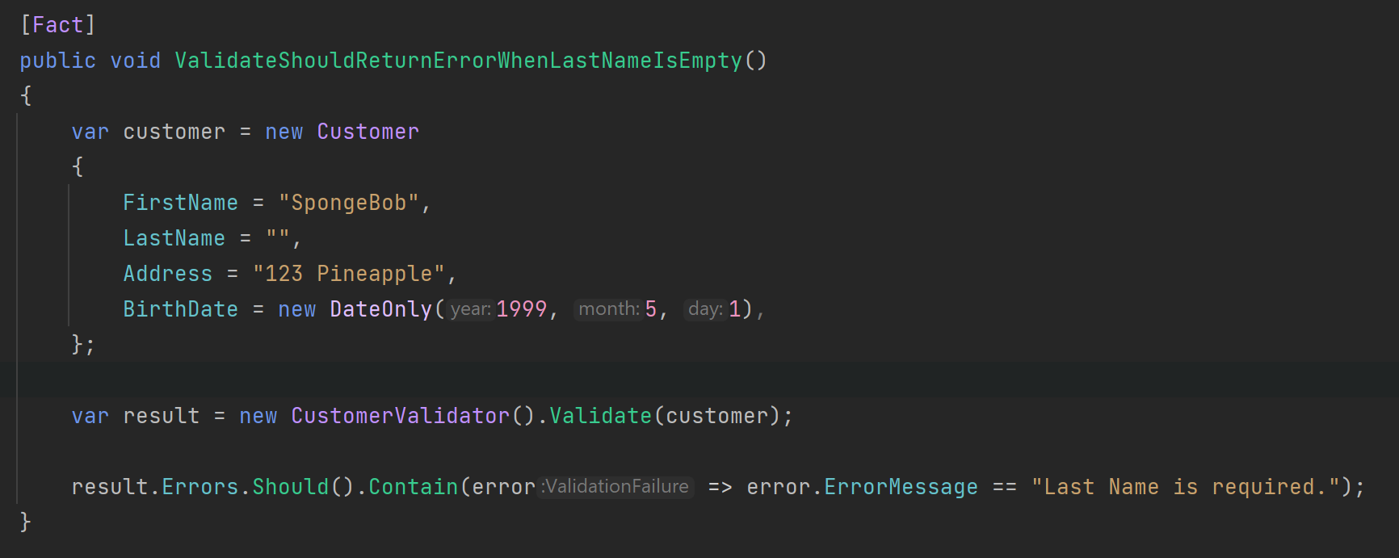
Chekhov’s Gun Applied to Testing
scottsauber

Slide 28
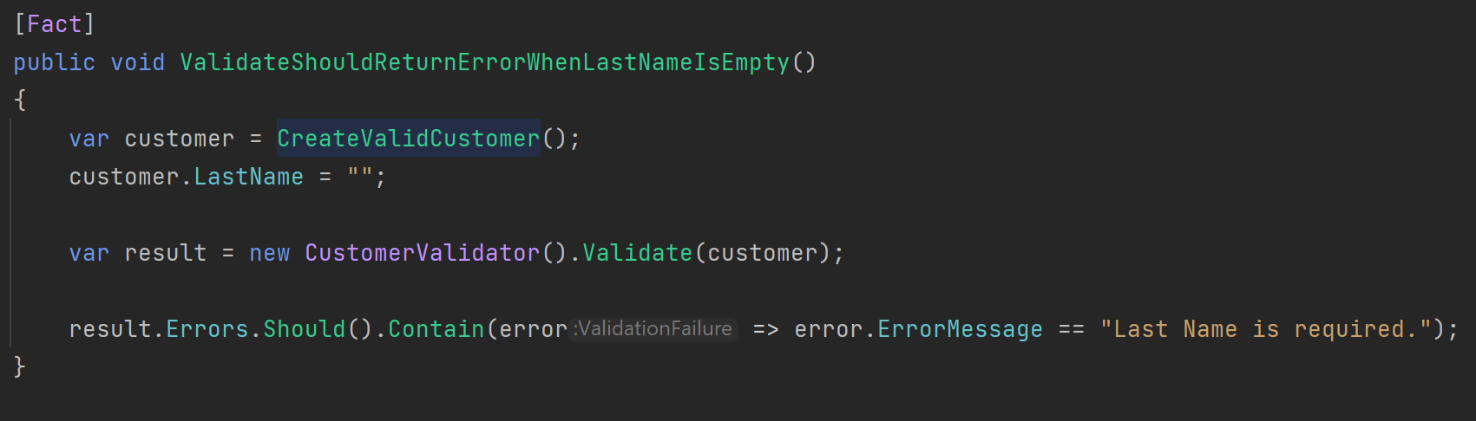
Chekhov’s Gun Applied to Testing
scottsauber

Slide 29
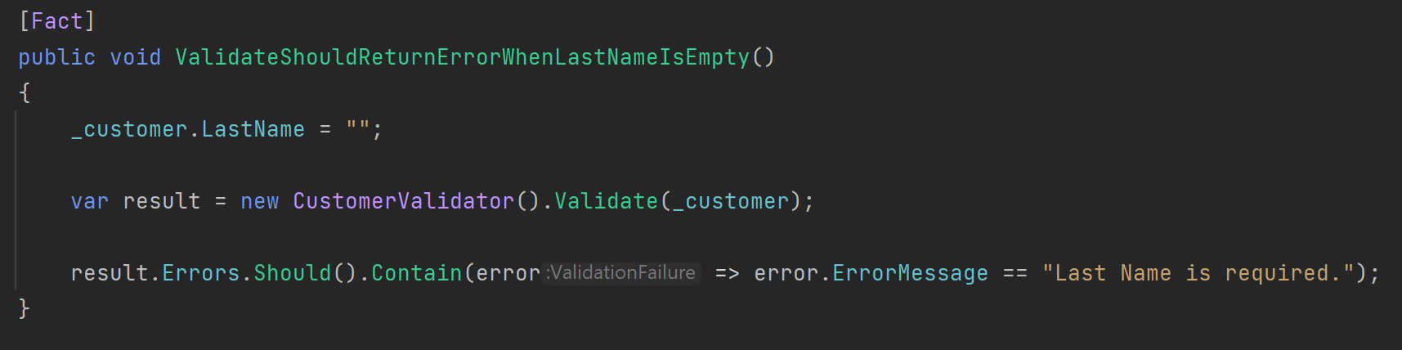
Chekhov’s Gun Applied to Testing
scottsauber

Slide 30
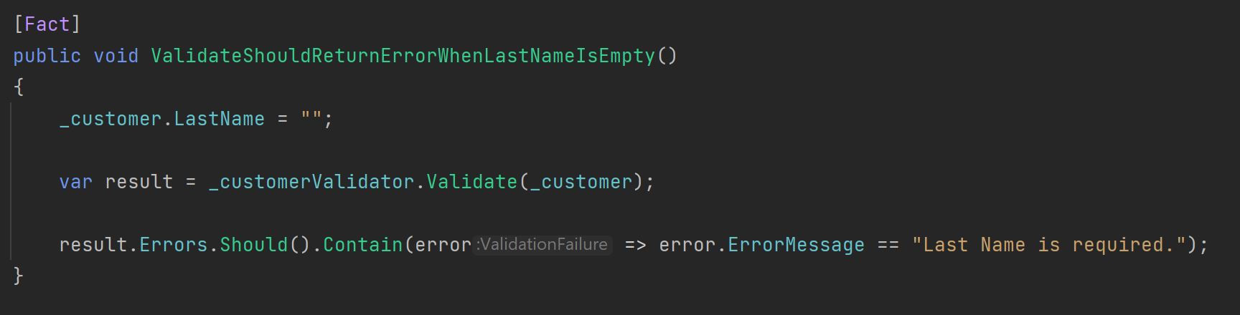
Chekhov’s Gun Applied to Testing
scottsauber

Slide 31
Chekhov’s Gun Applied to Testing
scottsauber

Slide 32
Back to TDD

Slide 33
Forms of TDD
“Bottom up” aka Detroit
“Top Down” aka London aka Acceptance TDD
scottsauber

Slide 34
Bottom up
Build the bottom most layers first
⚠️ Trigger warning ⚠️
Start with repository
Then work up to Service/Handler
Then work up to Controller
In my experience, it’s easier to teach someone bottom up
scottsauber

Slide 35
Top down
Start with a failing Integration Test (Acceptance)
Start with Controller
Then Service/Handler
Then Repository
Very Mock heavy
scottsauber

Slide 36
Neither style is “correct”
Pick the style that makes sense for you
I mix these – I start with a failing acceptance test then do bottom up
Why? Bottom up makes more sense to me
Sometimes I delete tests at the end if I don’t think they’re useful to keep around
That’s ok - they helped me design
scottsauber

Slide 37

But I don’t have time to write tests!

Slide 38

Why?
Notes:
Too understaffed
Too much support work fixing bugs

Slide 39

My boss won’t let me!

Slide 40

What about this person?
Notes:
What if you went to your surgeon and said “Hey I need this operation done” and he goes “Okay it’ll take 24 hours.” And if you respond “Okay but can you do it in 4?” …would you want to get surgery from the surgeon who agrees to that?
“Oh yeah I can totally do that surgery in 4 hours, I just need to not wash my hands, not wash the tools from the last surgery, and I’ll just use 5 stitches to sew you up instead of 50.”

Slide 41
You don’t get better at TDD by NOT doing TDD

Slide 42

The next bug you have is a great starting point

Slide 43
Takeaways
What kinds of tests are there
Why you should TDD
What to test
Chekhov’s Gun
Start doing TDD the next time you have a bug
scottsauber

Slide 44
Resources
Slides at scottsauber.com
TDD for React: https://www.youtube.com/watch?v=oNi7DV7fJcU
I’m giving a JetBrains Webinar on TDDing Blazor next month!
Going to be TDDing an entire feature
scottsauber

Slide 45
Questions? Contact: ssauber@leantechniques.com
Slides at scottsauber.com
scottsauber

Slide 46
Thanks!
Slides at scottsauber.com
scottsauber

